Slide 1
URL Shortener System Design
A comprehensive system design for building a scalable, high-performance URL shortening service

Slide 2
Stakeholder Analysis
Marketers
App Developers
Custom links, branded domains, campaign analytics
Stable APIs, automation, integrations
End Users
Analytics Consumers
Fast global redirects, reliable uptime
Aggregated click insights

Slide 3
Priority Matrix
1
2
Critical
High
Redirect latency, correctness, availability
Accurate analytics, strong API reliability
3
4
Medium
Low
Custom alias features, dashboard polish
Advanced segmentation, export tooling

Slide 4
Core Functional Requirements
Flexible Link Creation
Rapid Global Redirection
Comprehensive Click Tracking
Utilize auto-generated keys or custom aliases, with support for TTL, tags, and optional metadata.
Efficiently resolve GET /s/{id} requests with a 302 redirect, ensuring global p95 latency under 50 ms.
Capture critical click data including device type via User-Agent, geography via IP lookup, and referrer information.
Detailed Analytics Reporting
Access in-depth analytics, presenting total clicks, unique clicks, time-series charts, and breakdowns by top countries, referrers, and devices.

Slide 5
Non-Functional Requirements
Performance
Scale
Security
Availability: 99.99% for redirects
1B+ clicks/day
AuthN/AuthZ
p95 latency < 50ms
100k+ peak QPS
Rate limiting
p99 latency < 100ms
Never lose link mappings
Domain safety
Strong consistency for redirect mapping. Eventual consistency for analytics. Global delivery via Anycast + multi-region.

Slide 6
System Architecture
Our system architecture prioritizes high traffic, fast redirects, and reliable analytics through these core principles:
CDN for Redirects: A Content Delivery Network handles 95% of requests, ensuring low latency (p95 < 50ms) and global distribution.
Asynchronous Analytics: Analytics are processed asynchronously, minimizing impact on user redirect experiences and allowing for scalable data processing.
Centralized Writes: Critical link mappings maintain strong consistency via write operations centralized to a single primary region.
Multi-Region Deployment: Supported by Anycast DNS, this enables handling 1 billion+ clicks daily and peak loads exceeding 100,000 QPS.

Slide 7

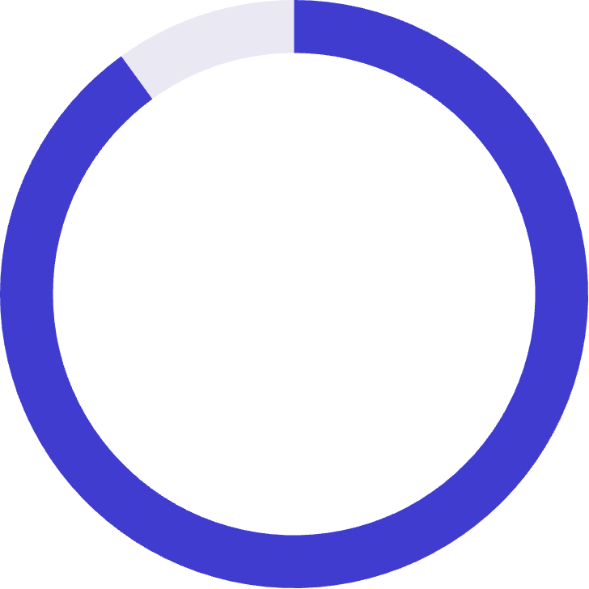
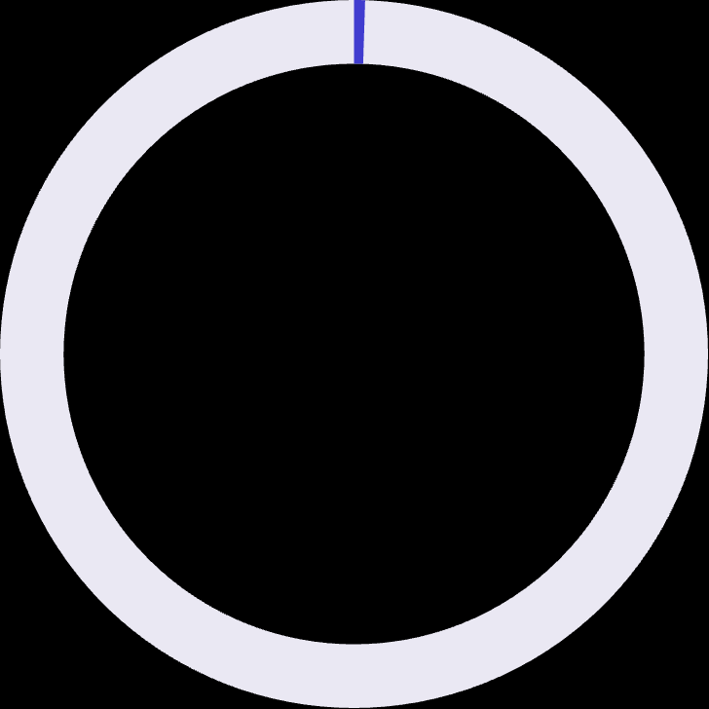
Capacity Planning
100M
1B
100K+
Short Links
Clicks/Day
Peak QPS
~12k clicks/sec average
Cache Efficiency
95%
90%
0.5%
CDN Handles
Edge Cache
DB Traffic
Of remaining 5%
~500 QPS to database

Slide 8
API Specifications
POST /v1/links
1
Request: { long_url, custom_alias?, ttl?, metadata? }
Response: { short_id, short_url }
GET /s/{short_id}
2
Returns 302 redirect
GET /v1/links/{id}/stats
3
Returns analytics aggregates

Slide 9
Caching & Resiliency Strategy
Caching Layers
Resiliency
CDN caching: 30–60 seconds
Circuit breakers around DB + Kafka
Edge Redis: 1–24 hours
Retry with exponential backoff
Local LRU: microsecond lookups
Regional failover via Anycast
Rate Limiting
Redirect continues if analytics degrades
Per-IP throttling
Per-token API limits
Malicious domain blocklist

Slide 10
Quality Targets & Trade-Offs
Category
Target
Redirect availability
99.99%
Redirect latency p95
< 50ms
Analytics freshness
95% < 5 minutes
API availability
99.9%
Strong consistency increases redirect correctness but adds write latency. Eventual consistency in analytics allows massive scale at lower cost. CDN caching improves performance but requires purge workflows.

